Slide 1

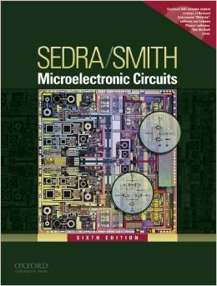
International University
School of Electrical Engineering
ANALOG ELECTRONICS
Lecture # 4: Frequency Response
Text book:
Sedra and Smith, “Microelectronic Circuits,” 6th Edition.

Slide 2
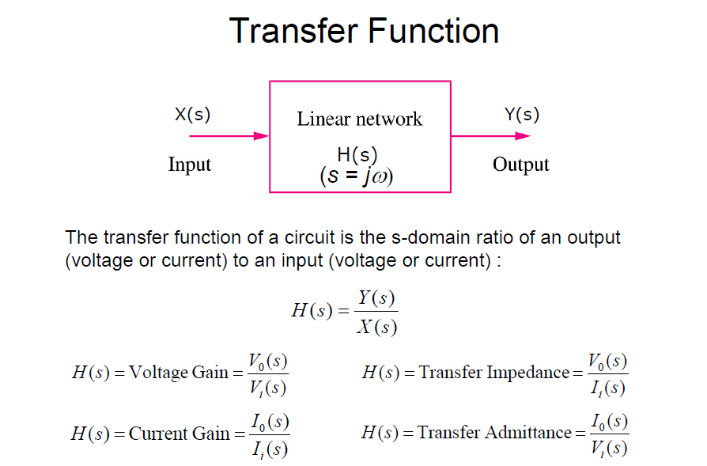

Slide 3
Transfer function: poles, zeros
Most of our work in this chapter will be concerned with finding amplifier voltage gain as a transfer function of the complex frequency s.
A capacitance C: is equivalent an impedance 1/sC
An inductance L: is equivalent an impedance sL
Voltage transfer function: by replacing s by jω, we can obtain its magnitude response and phase response

Slide 4
Transfer function: poles, zeros
Z1, Z2, … Zm are called the transfer-function zeros or transmission zeros.
P1, P2, … P_{n} are called the transfer-function poles or natural modes.
The poles and zeros can be either real or complex numbers, the complex poles (zeros) must occur in conjugate pairs.

Slide 5
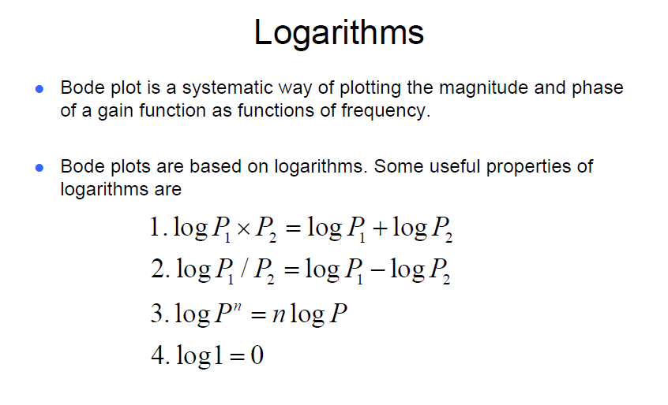
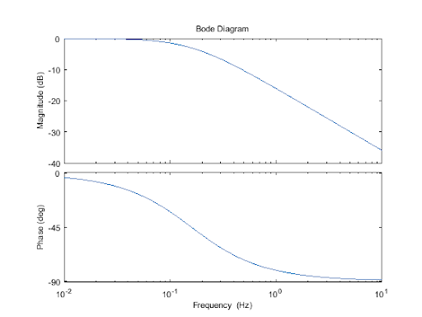

Slide 6
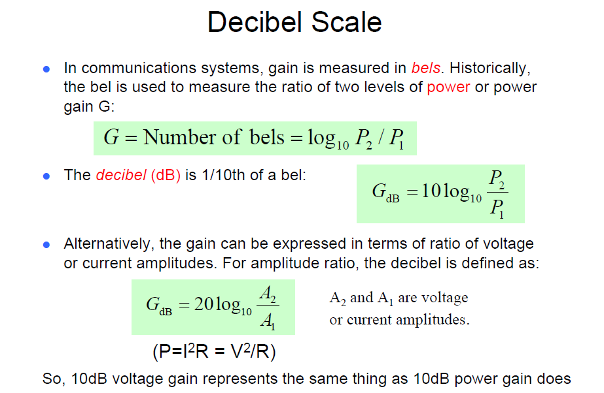

Slide 7
First-order Functions
All the transfer functions encountered in this chapter have real poles and zeros and can be written as the product of first-order transfer functions.
ω0, called the pole frequency, is equal to the inverse of the time constant of circuit network (STC).
RC

Slide 8
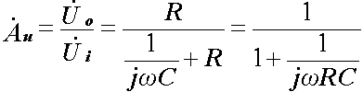

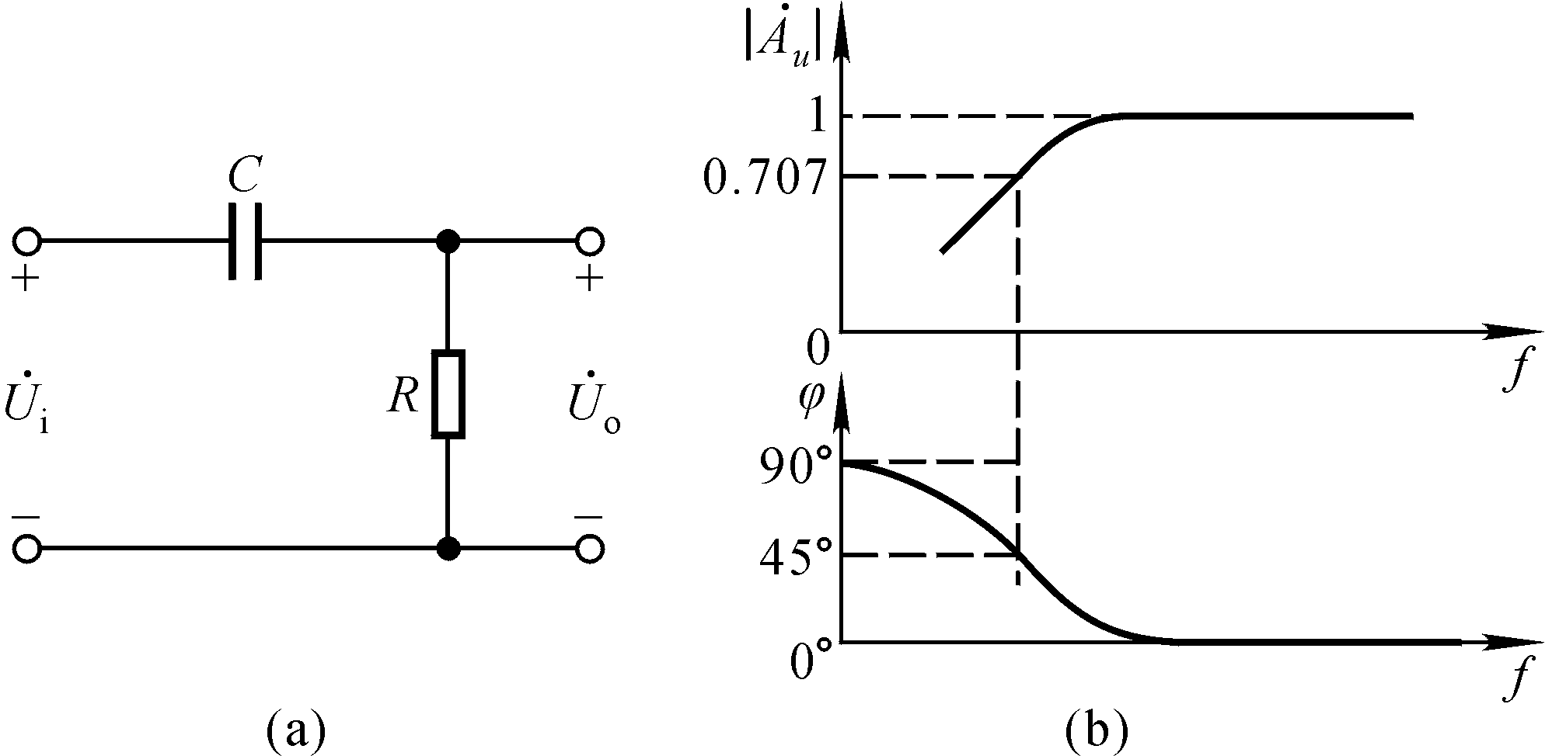
Example 1: High pass circuit
RC is the time constant; ω_{L}=1/RC

Slide 9
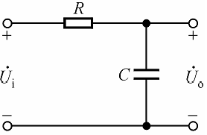
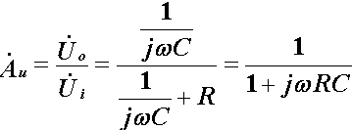
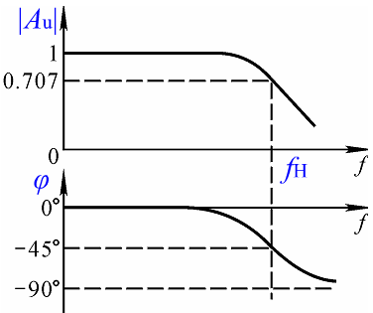
Example 2: Low pass circuit
RC is the time constant; ωH = 1/RC

Slide 10
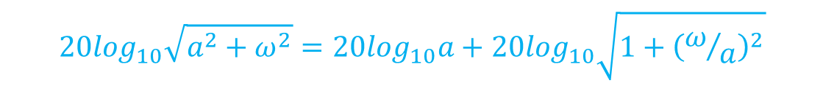
Bode Plots
A simple technique exists for obtaining an approximate plot of the magnitude and phase of a transfer function given its poles and zeros. The resulting diagram is called Bode plots
A transfer function consists of a product of factors of the form s+a
$$20\log_{10}\sqrt{a^{2}+ω^{2}}=20\log_{10}a+20\log_{10}\sqrt{1+{\left(ω/a\right)}^{2}}$$

Slide 11
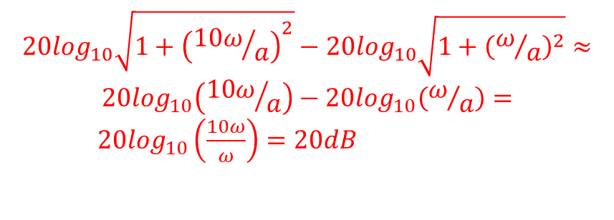
Bode Plots
Magnitude of a zero
$$20\log_{10}\sqrt{1+{\left({10ω}/a\right)}^{2}}−20\log_{10}\sqrt{1+{\left(ω/a\right)}^{2}}≈$$
$$20\log_{10}\left({10ω}/a\right)−20\log_{10}\left(ω/a\right)=$$
$20\log_{10}\left(\frac{10ω}{ω}\right)=20dB$

Slide 12
Example 3

Slide 13
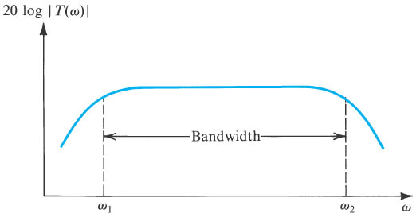
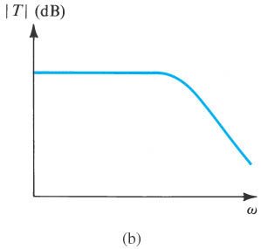
The amplifier transfer function
(a) a capacitively coupled amplifier (b) a direct-coupled amplifier

Slide 14
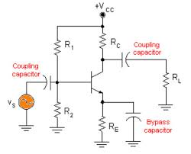
The Gain Function
Gain function
Midband: No capacitors in effect
Low-frequency band: coupling and bypass capacitors in effect
High-frequency band: transistor internal capacitors in effect

Slide 15

GENERALIZED CAPACITOR-COUPLED AMPLIFIER
FREQUENCY RESPONSE
2 plots represent DC-coupled (left) and AC-coupled (right) amplifiers. The single transistor amplifiers generally need input & output coupling capacitors so that external DC voltages do not shift the bias point. Thus, these will have AC-coupled responses.
• For the AC-coupled response, near ω_{L} and below, the amplifier’s response acts like a high-pass filter.
• For both cases, near ω_{H} and above, the amplifier’s response acts like a low-pass filter.
• The (hopefully) flat region in the middle is the “mid-band.” We typically talk about the “mid-band gain” of an AC-coupled amplifier.
• It is important to note that one can look at the transfer function of an AC-coupled amplifier as the product of the high-pass, mid-band, and low-pass transfer functions,
Reminder: The impedance of a capacitor is
Thus, they are open-circuits at DC and shorts at very high frequencies.

Slide 16
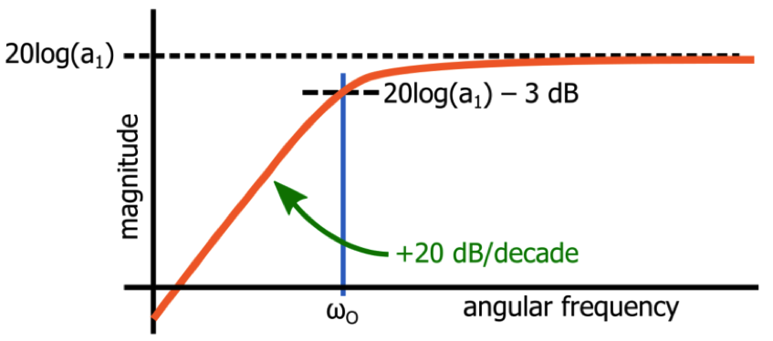
DOMINANT POLES
Dominant poles are poles that dominate over the others in the transfer function so that the low- or high-frequency response of an amplifier can be approximated as a first-order high- or low-pass filter.
DOMINANT LOW-FREQUENCY POLE
If there is a dominant low-frequency pole (this is the one that acts like a HIGH-PASS filter), the low-frequency response can be approximated as,
So, if the “full” low-frequency response is
this means that ω_{P1} is at a much HIGHER frequency than the other poles so that it can DOMINATE...
• Note that the number of poles and zeros must be equal (at that point) if the function “flattens out” in the mid-band!
If there is no dominant pole, we can make the following approximation

Slide 17

DOMINANT POLES
DOMINANT HIGH-FREQUENCY POLE
If there is a dominant high-frequency pole (this is the one that acts like a LOW-PASS filter), the high-frequency response can be approximated as:
So, if the “full” high-frequency response is
this means that ω_{P1} is at a much LOWER frequency than the other poles so that it can DOMINATE...
Note that the number of poles and zeros must be equal (at that point) if the function “flattens out” in the mid-band!
If there is no dominant pole, you can make the following approximation
f

Slide 18
SHORT-CIRCUIT AND OPEN-CIRCUIT TIME CONSTANT METHODS FOR APPROXIMATING THE RESPONSE OF AMPLIFIERS
This is a very useful method for approximating upper and lower cut-off frequencies, assuming that there is a dominant pole.
Depending on which of the two methods we use, for each capacitor in the circuit, we replace the capacitors in the circuit, except for the one you are looking at, with either shorts or opens.
Two key rules apply to both methods:

Slide 19
SHORT-CIRCUIT AND OPEN-CIRCUIT TIME CONSTANT METHODS FOR APPROXIMATING THE RESPONSE OF AMPLIFIERS
OPEN-CIRCUIT TIME CONSTANTS FOR UPPER CUT-OFF FREQUENCY APPROXIMATION
All we have to do is step through the process of calculating a “local” RC time-constant for each capacitor in the circuit.
For each capacitor you set all other capacitances (other than the one you are looking at) to zero (i.e. they become OPEN CIRCUITS as if they have not yet had any effect on the amplifier's roll-off) and determine the resistance, R_{io}, seen by C_{i} (the capacitor you are working with).
• Repeat this process for each capacitor.
• The upper cut-off frequency is then approximately given by,
This approach can tell you which of the capacitances in a circuit is most significant in determining the high-frequency response!

Slide 20
SHORT-CIRCUIT AND OPEN-CIRCUIT TIME CONSTANT METHODS FOR APPROXIMATING THE RESPONSE OF AMPLIFIERS
SHORT-CIRCUIT TIME CONSTANTS FOR LOWER CUT-OFF FREQUENCY APPROXIMATION
• Again, all you have to do is step through the process of calculating a “local” RC time-constant for each capacitor in the circuit.
For each capacitor you set all other capacitances (other than the one you are looking at) to INFINITY (i.e. they become SHORT CIRCUITS as if they have already become low enough impedance to neglect) and determine the resistance, R_{iS}, seen by C_{i} (the capacitor you are working with).
• Repeat this process for each capacitor.
• The lower cut-off frequency is then approximately given by,
This approach can tell you which of the capacitances in a circuit is most significant in determining the low-frequency response!

Slide 21
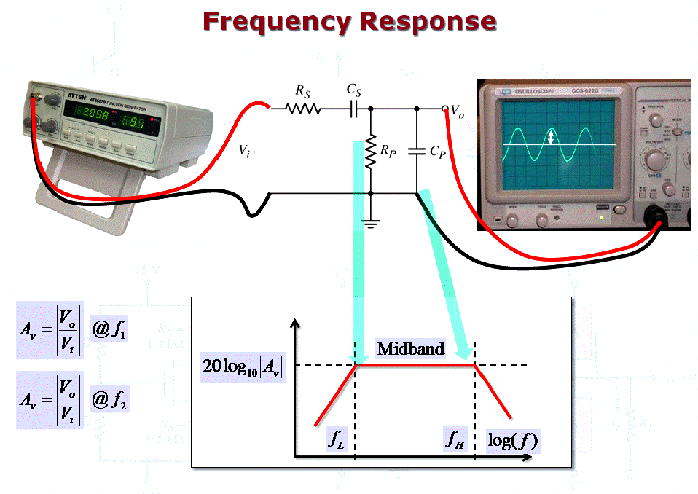

Slide 22
Introduction
IN THIS CHAPTER YOU WILL LEARN
How coupling and bypass capacitors cause the gain of discrete circuit amplifiers to fall off at low frequencies, and how to obtain an estimate of the frequency f_{L} at which the gain decreases by 3dB below its value at midband.
The internal capacitive effects present in the MOSFET and the BJT and how to model these effects by adding capacitances to the hybrid-p model of each of the two transistor types.
The high-frequency limitation on the gain of the CS and CE amplifiers and how the gain falloff and the upper 3-dB frequency f_{H} are mostly determined by the small capacitances between the drain and gate (collector and base).

Slide 23
Introduction
IN THIS CHAPTER YOU WILL LEARN
Powerful methods for the analysis of the high-frequency response of amplifier circuits of varying complexity.
How the cascode amplifier studied in Chapter 7 can be designed to obtain wider bandwidth than is possible with CS and CE amplifiers.
The high-frequency performance of the source and emitter followers.
The high-frequency performance of differential amplifiers.
Circuit configurations for obtaining wideband amplification.

Slide 24
Introduction
Previously assumed that gain is constant and independent of frequency.
implied that bandwidth was infinite
this is not true
Middle-frequency band (midband) is the range of frequencies over which device gain is constant.

Slide 25
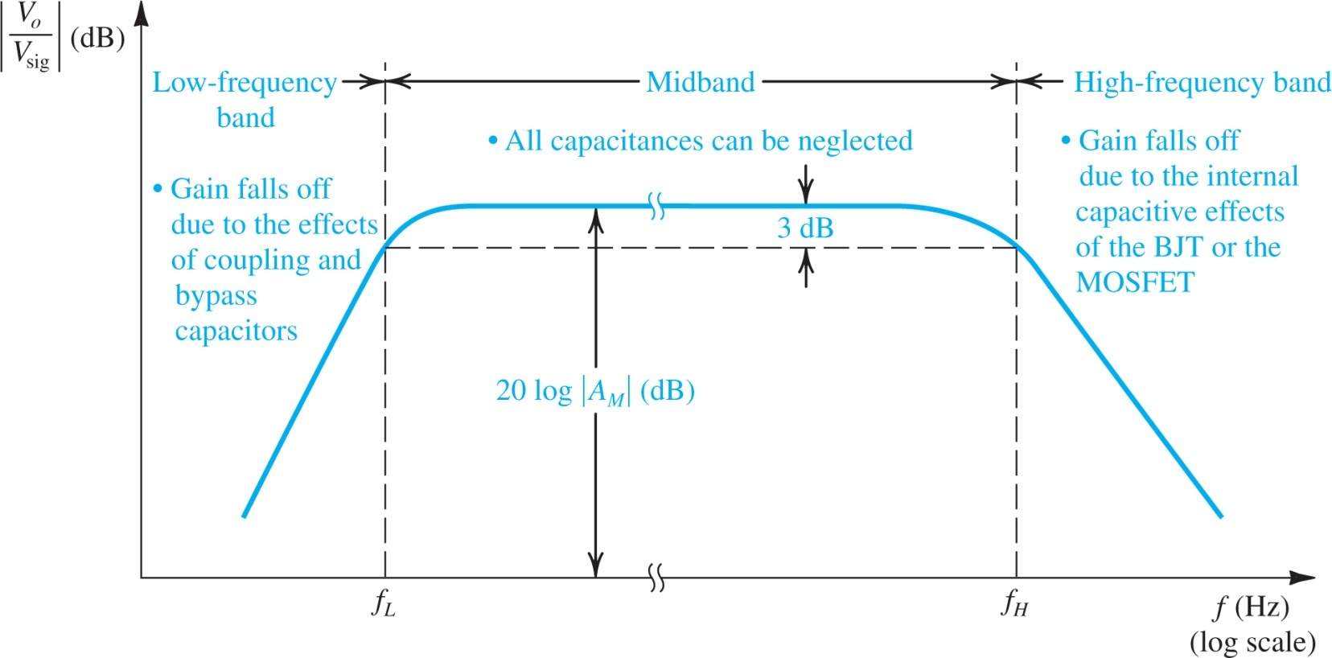
Figure 9.1: Sketch of the magnitude of the gain of a discrete-circuit BJT or MOS amplifier versus frequency. The graph delineates the three frequency bands relevant to frequency-response determination.
Midband:
The frequency range of interest for amplifiers
Large capacitors can be treated as short circuit and small capacitors can be treated as open circuit
Gain is constant and can be obtained by small-signal analysis
Amp. bandwidth is defined by f_{L} and f_{H}
BW ≡ f_{H} − f_{L}
Notes:
single-time-constant (STC)

Slide 26
Figure 9.1: Sketch of the magnitude of the gain of a discrete-circuit BJT or MOS amplifier versus frequency. The graph delineates the three frequency bands relevant to frequency-response determination.
Low-frequency band:
Gain drops at frequencies lower than f_{L}
Large capacitors can no longer be treated as short circuit
The gain roll-off is mainly due to coupling and by-pass capacitors

Slide 27
Figure 9.1: Sketch of the magnitude of the gain of a discrete-circuit BJT or MOS amplifier versus frequency. The graph delineates the three frequency bands relevant to frequency-response determination.
High-frequency band:
Gain drops at frequencies higher than f_{H}
Small capacitors can no longer treated as open circuit
The gain roll-off is mainly due to parasitic capacitances of the MOSFETs and BJTs

Slide 28
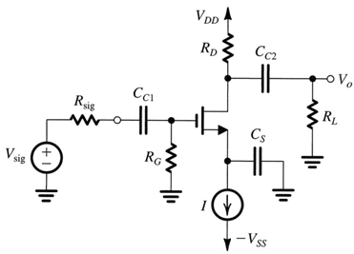
9.1. Low Frequency Response of the Common-Source and Common-Emitter Amplifiers
Figure 9.2(a) shows a discrete-circuit, common-source amplifier.
coupling capacitors C_{C1} and C_{C2}
bypass capacitor C_{S}
Objective is to determine the effect of these capacitances on gain (V_{o}/V_{sig}).
At low frequencies, their reactance (1/jωC) is high and gain is low.
(a)
Figure 9.2: (a) Capacitively coupled common-source amplifier.

Slide 29
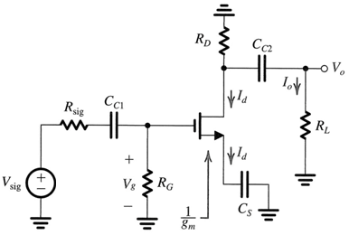
9.1.1. The CS Amplifier
Determining V_{o}/V_{sig}
figure 9.2(b) illustrates this process
circuit with dc sources eliminated
small-signal analysis
ignore r_{o}
(a)
Figure 9.2: (b) Analysis of the CS amplifier to determine its low-frequency transfer function. For simplicity, r_{o} is neglected.
(b)

Slide 30
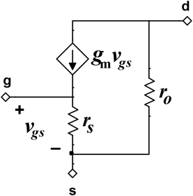
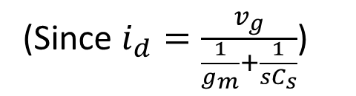
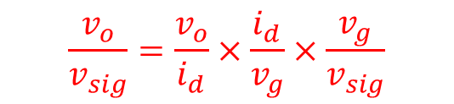
9.1.1. The CS Amplifier
$$\frac{v_{o}}{v_{sig}}=\frac{v_{o}}{i_{d}}×\frac{i_{d}}{v_{g}}×\frac{v_{g}}{v_{sig}}$$
The effect of the coupling capacitor C_{C1} is to introduce a high-pass STC response with a break frequency ω_{P1}.
(Since $i_{d}=\frac{v_{g}}{\frac{1}{g_{m}}+\frac{1}{sC_{s}}}$)
1/g_{m}
T-model of MosFet
Notes:
single-time-constant (STC)

Slide 31
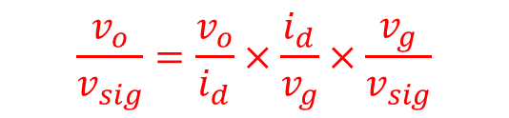
9.1.1. The CS Amplifier
$$\frac{v_{o}}{v_{sig}}=\frac{v_{o}}{i_{d}}×\frac{i_{d}}{v_{g}}×\frac{v_{g}}{v_{sig}}$$
C_{C2} introduces a third STC high-pass factor,
(All capacitors are short-circuited. Use π-model)

Slide 32
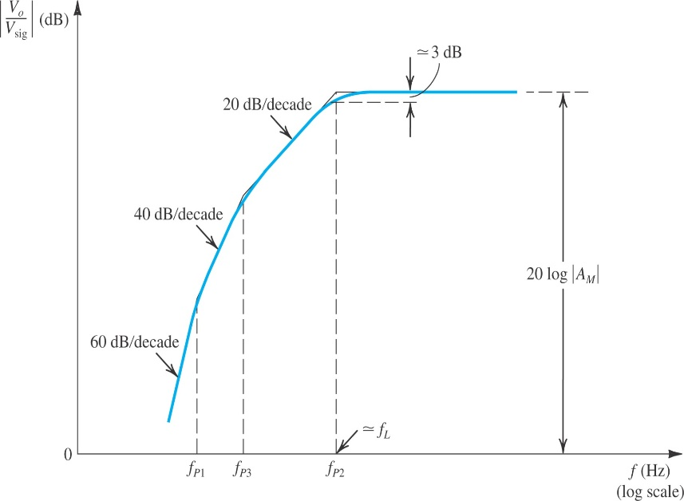
9.1.1. The CS Amplifier
Determining the lower 3-dB frequency
* Coupling and by-pass capacitors result in a high-pass frequency response with three poles
* If the poles are sufficiently separated
Bode plot can be used to evaluate the response for simplicity
The lower 3-dB frequency is the highest-frequency pole
ω_{P2} is typically the highest-frequency pole due to small resistance of 1/g_{m}
* If the poles are located closely
The lower 3-dB frequency has to be evaluated by the transfer function which is more complicated
Determining the pole frequency by inspection
* Reduce V_{sig} to zero
* Consider each capacitor separately (treat the other capacitors as short
circuit)
* Find the total resistance between the terminals of each capacitor.
Selecting values for the coupling and by-pass capacitors
* These capacitors are typically required for discrete amplifier designs
* C_{S} is first determined to satisfy needed f_{L}
* C_{C1} and C_{C2} are chosen such that poles are 5 to 10 times lower than f_{L}

Slide 33
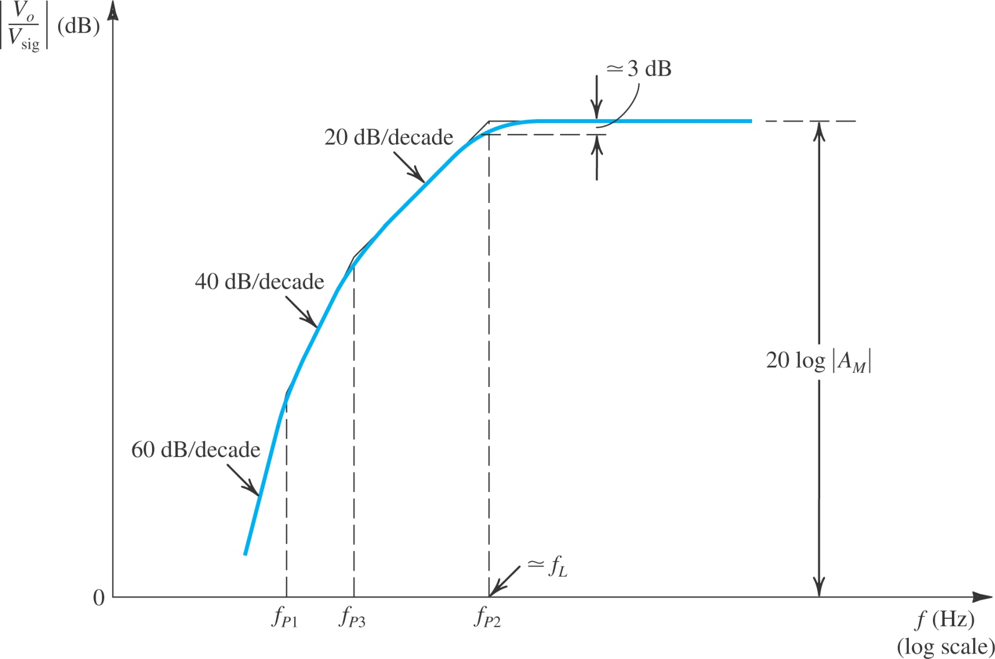
Figure 9.3: Sketch of the low-frequency magnitude response of a CS amplifier for which the three pole frequencies are sufficiently separated for their effects to appear distinct.

Slide 34
9.1.1. The CS Amplifier - Example 9.1
We wish to select appropriate values for the coupling capacitors C_{C1} and C_{C2} and the bypass capacitor C_{S} for a CS amplifier for which R_{G} = 4.7 MΩ, R_{D} = R_{L} = 15 kΩ, R_{sig} = 100 kΩ, and g_{m} = 1 mA/V.
It is required to have f_{L} at 100 Hz and that the nearest break frequency be at least a decade lower.

Slide 35
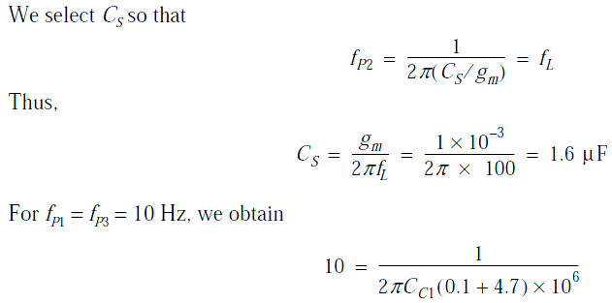
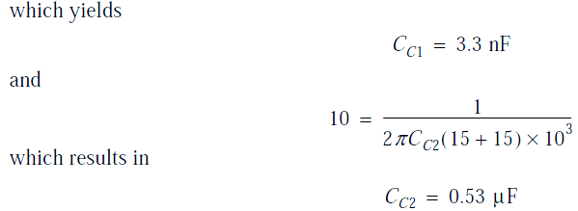
9.1.1. The CS Amplifier - Example 9.1
Solution

Slide 36
9.1.2. The CE Amplifier
Figure 9.4. shows common-emitter amplifier.
coupling capacitors C_{C1} & C_{C2}
emitter bypass capacitor C_{E}
Effect of these capacitors felt at low frequencies.
Objective is to determine amplifier gain and transfer function.
This analysis is somewhat more complicated than CS case.
(a)
Low frequency small signal analysis:
1) Eliminate the DC source
2) Ignore C_{π} and C_{μ} and r_{o}
3) Ignore r_{x}, which is much smaller than rπ
(b)
The circuit prepared for small-signal
analysis

Slide 37
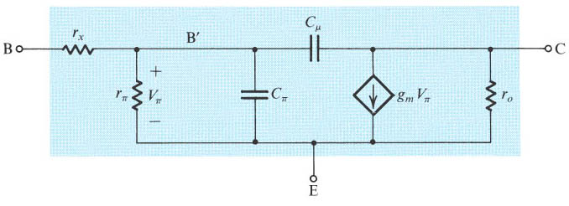
The High-Frequency Hybrid-π Model
Two capacitances C_{π} and C_{μ} , where
One resistance r_{x} . Accurate value is obtained from high frequency measurement.

Slide 38
9.1.2. The CE Amplifier
• Considering the effect of each of the three capacitors separately.
The effect of C_{C1} is determined with C_{E} & C_{C2} assumed to be acting as short circuits:
Figure 9.5 (a)
The voltage Vπ at the base of the transistor can be written as
The output voltage is obtained as:
Notes:
consider the effect of the three capacitors C_{C1}, C_{E}, & C_{C2} one at a time. → when finding the effect of C_{C1}, we shall assume that C_{E} & C_{C2} are acting as perfect short circuits, and so on.

Slide 39
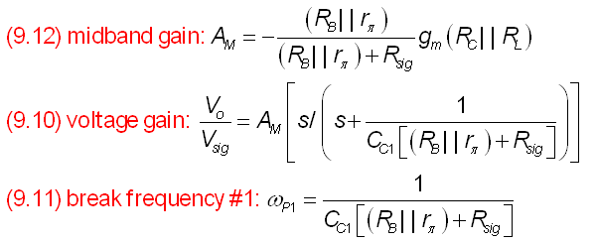
9.1.2. The CE Amplifier

Slide 40
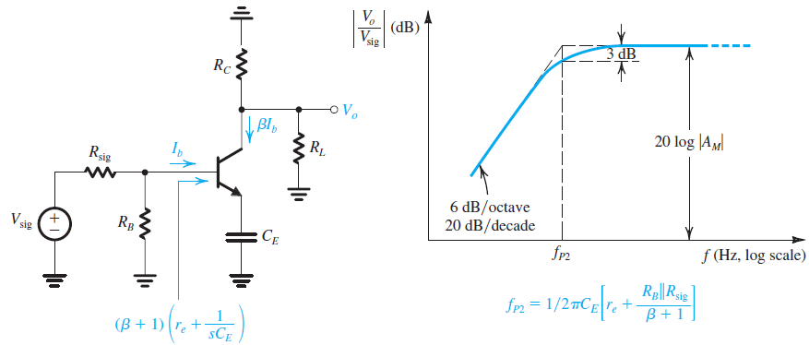

9.1.2. The CE Amplifier
The effect of C_{E}. For this purpose we assume that C_{C1} and C_{C2} are acting as perfect short circuits and thus obtain the circuit in Fig. 9.5(b)
Figure 9.5 (b)
Base current

Slide 41
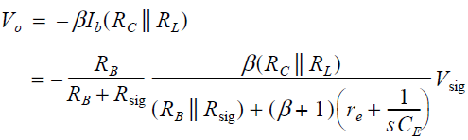
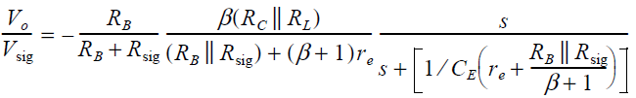
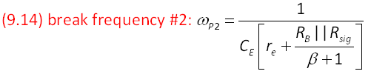
9.1.2. The CE Amplifier
output voltage
Thus the voltage gain including the effect of C_{E} can be expressed

Slide 42
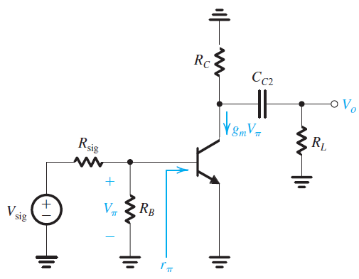
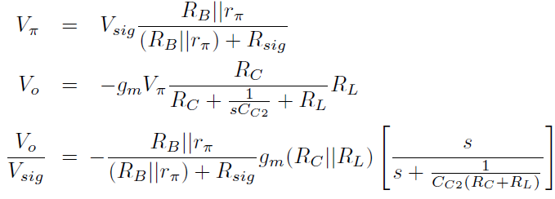
9.1.2. The CE Amplifier
Finally, we consider the effect of C_{C2}. The circuit with C_{C1} and C_{E} assumed to be acting as perfect short circuits is shown in Fig. 9.5(c), for which we can write
Figure 9.5: (c)
low-frequency gain including the effect
of C_{C2}

Slide 43

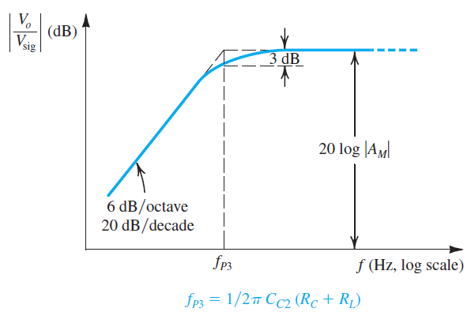
9.1.2. The CE Amplifier
We observe that C_{C2} introduces the frequency-dependent factor between the square brackets, which we recognize as the transfer function of a high-pass STC circuit with a pole frequency ω_{P3},
(R_{C} + R_{L}) is the resistance seen between the terminals of C_{C2} when V_{sig} is set to zero. → C_{C2} causes the low-frequency gain of the amplifier to decrease at the rate of 6 dB/octave with a 3-dB frequency at as illustrated by the sketch in Fig. 9.5(c).
Figure 9.5: (c)

Slide 44
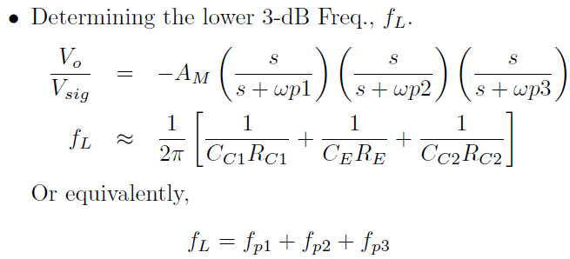
9.1.2. The CE Amplifier
where R_{C1}, R_{E}, and R_{C2} are the resistances seen by C_{C1}, C_{E}, and C_{C2}, respectively, when V_{sig} is set to zero and the other two capacitances are replaced with short circuits.

Slide 45
Selecting Values for C_{C1}, C_{E}, and C_{C2}
Selecting Values for C_{C1}, C_{E}, and C_{C2}: We now address the design issue of selecting appropriate values for C_{C1}, C_{E}, and C_{C2}. The design objective is to place the lower 3-dB frequency f_{L} at a specified location while minimizing the capacitor values. Since, as mentioned above, C_{E} usually sees the lowest of the three resistances, the total capacitance is minimized by selecting C_{E} so that its contribution to f_{L} is dominant. That is, by reference to Eq. (9.18), we may select C_{E} such that is, say, 80% of ωL = 2π f_{L}, leaving each of the other capacitors to contribute 10% to the value of ω_{L}.

Slide 46
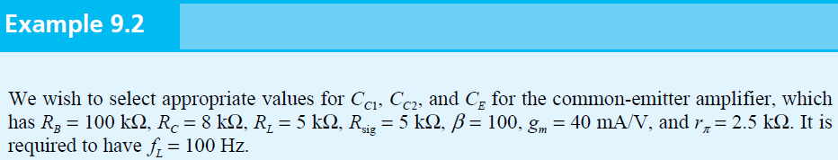
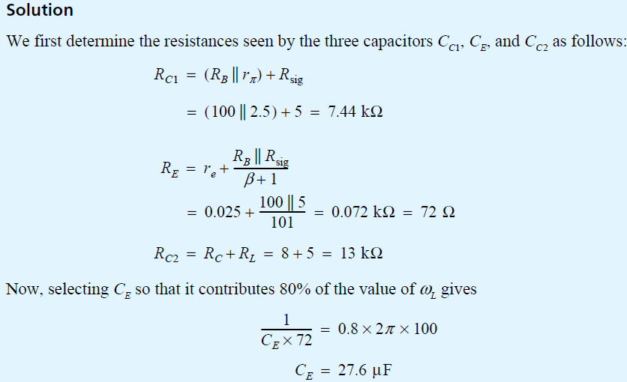

Slide 47
